Slide 1
Lab Tools Workshop
Fall 19
Henry Kou, Evan Brown

Slide 2
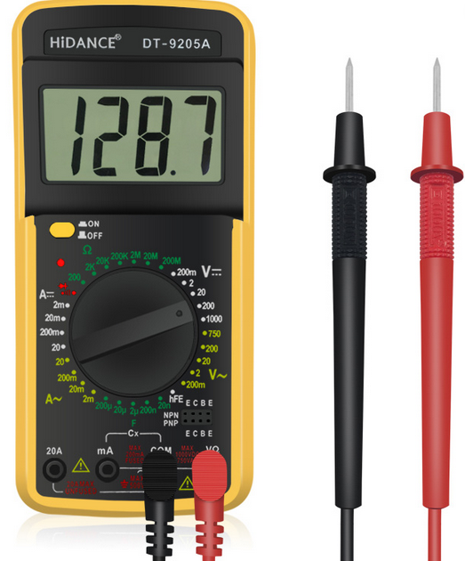
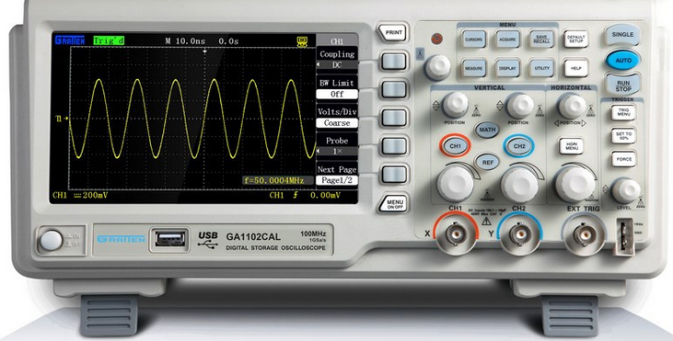
What Tools Do We Use?
In most projects there will be a need to do testing or use tools to assist in the operation of devices
The most common tools we use are DMM (digital multimeters), Oscilloscopes and Electronic Power Supplies
They help us power and debug circuits to find and fix problems

Slide 3
Further Notes
Not all tools have the same features between them so it’s important to look up directions for a device if you’re unsure about it
Each device also works differently and its important to understand what the device is doing in order to know how and why to use it in certain ways

Slide 4
DMMs
Dmms are used by engineers and non engineers. You probably have one in a drawer to check the voltage on your batteries
They can act as voltmeters, ammeters, continuity testers, and can measure resistances
Voltmeter settings are used in parallel with a circuit
Ammeter settings are used in series with a circuit
Ohmmeter settings are usually used separately

Slide 5
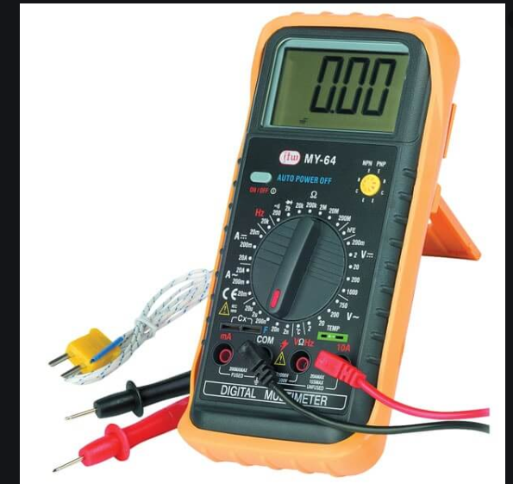
How to set the DMM up
The DMM has between 3 and 4 holes on the bottom. The black hole (usually labeled COM) is for the black wire and is associated with the negative terminal of devices
The other two terminals will usually have a V or Ω to denote that as the voltmeter and continuity probe while the other will be labeled with an A or mA denoting the ammeter

Slide 6
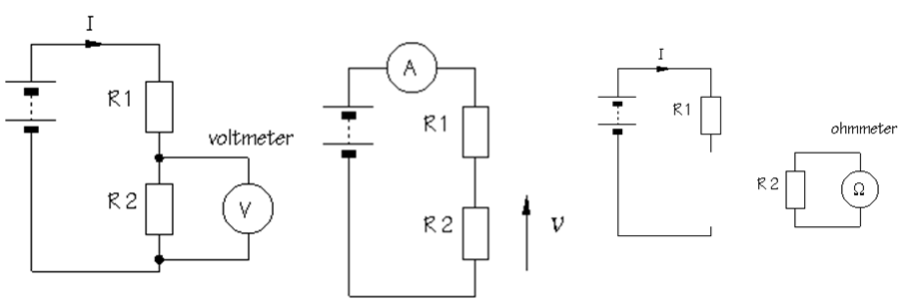
Parallel vs. Series
Series refers to items being directly in a line, in our circuits that means current must flow through each component to get to the next (The second picture displays a series circuit)
Parallel refers to items being beside each other, in our circuits that means that the two components will get the same voltage (The first picture displays a voltmeter in parallel with R2)

Slide 7

Continuity tests
Flipping to the sound wave shape puts the DMM in continuity test mode
This mode is useful for seeing if two points in a circuit are connected with low resistance between them
The practical application is to find shorted wires and to make sure that connected points (such as ground) are connected across different parts of a circuit
The test beeps when the two components are connected

Slide 8
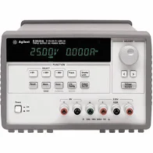
Power Supplies
Power supplies can be very varied. High quality ones provide protections to help prevent accidents when testing equipment and circuits
Can set voltage or current and set specified protection levels
Commonly you will want to set current limits to protect your circuits from getting to much power and overloading

Slide 9
Power Supply Setup
The first step would be to know the limits of the device you are testing. Such information is usually within a datasheet for the device. If you can’t find it there are always people and other resources to use to find out (officers, stackexchange, etc…)
Once known you can set the limits of the device. Each device is different for setting this so consulting the manual is recommended
Then you can place probes in and use it like a power supply

Slide 10
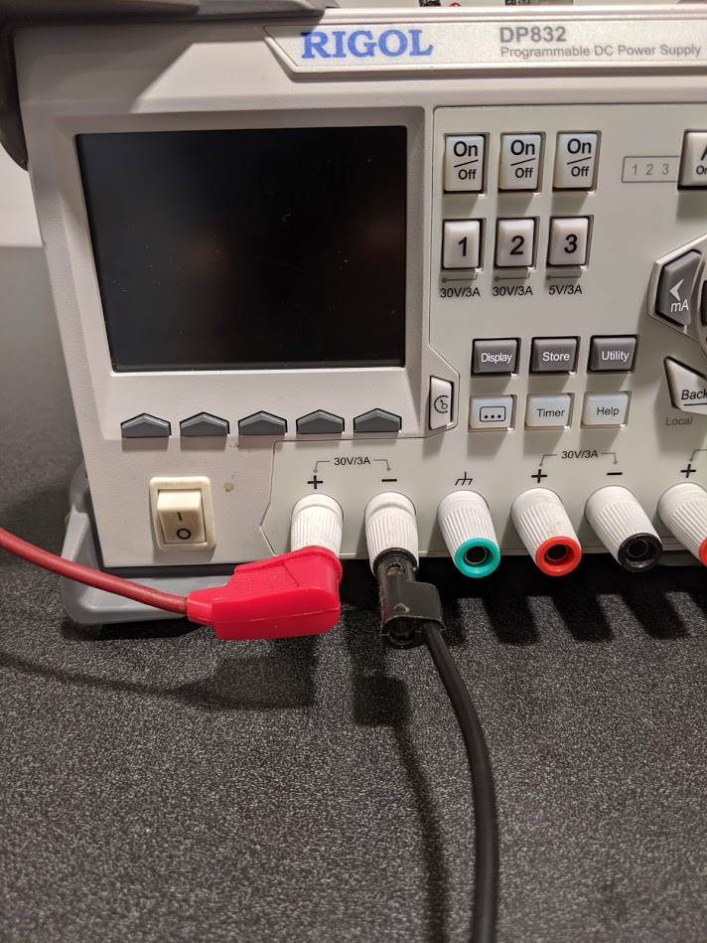
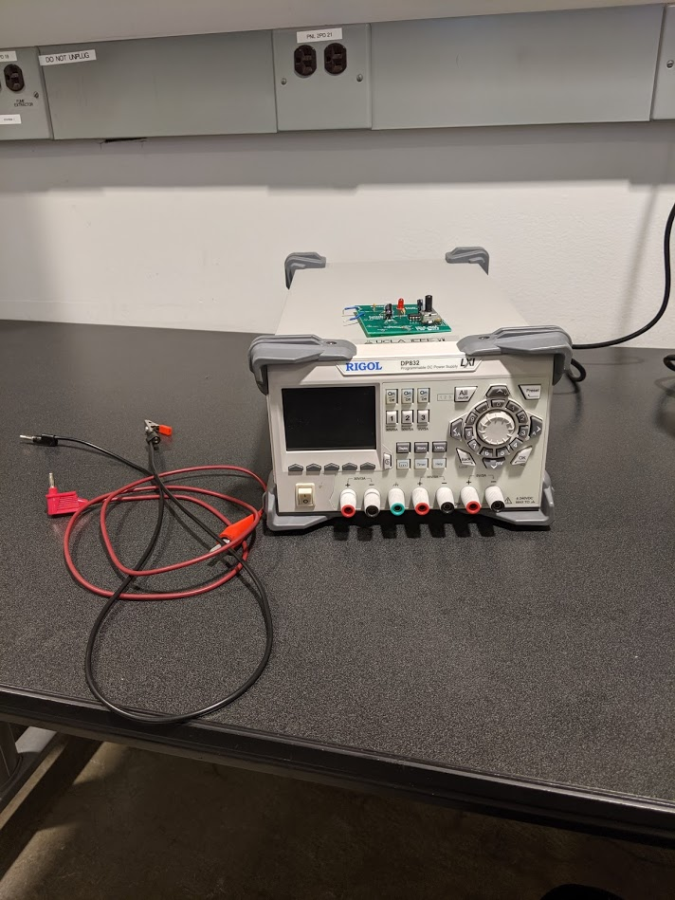
POWER SUPPLY DEMO
Proper Probe Placement on the first channel. The other ends are alligator clip to attach to leads but other tips are available

Slide 11
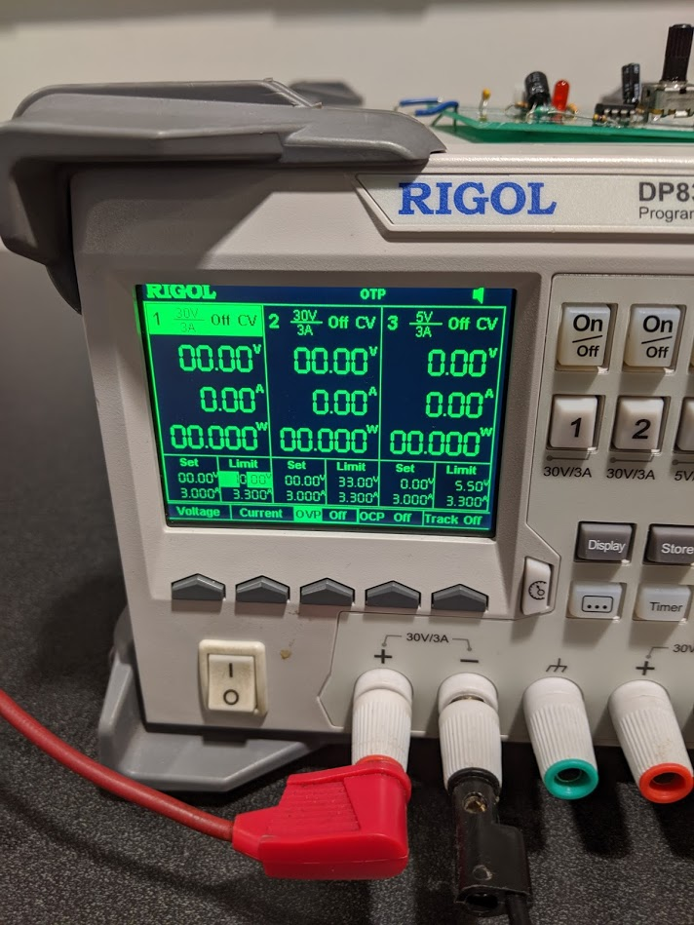
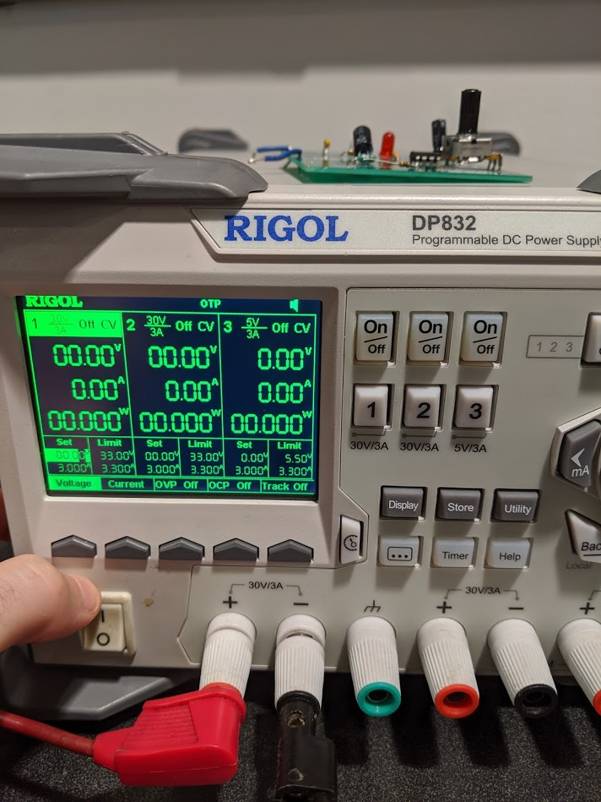
The “soft keys” that select between setting voltage, current, OVP, OCP and tracking(multi output use)
The power switch on the left (sometimes on back)

Slide 12
The on button for the first output set, will light up when pressed and on and the display on the screen will change to your settings
Note: You might need to press the OVP and OCP buttons twice to actually turn them on (check on or off on the display

Slide 13
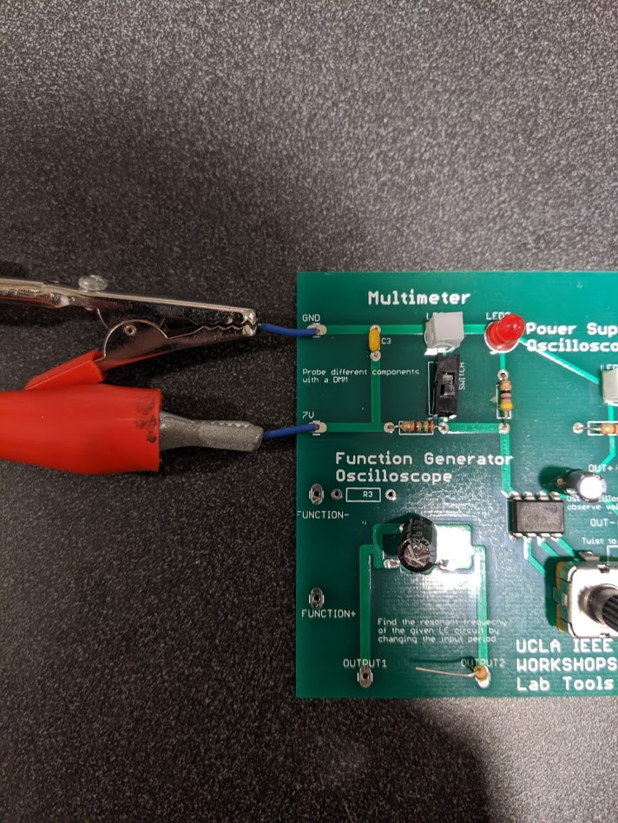
General button pad for selecting the digits for setting voltage, current, OVP, OCP. Can use the numbers or the up or down key to change the values. Note: Sometimes you can’t put certain values in such as 0 for OCP so to go so change the value within the operating range
Proper placement of the alligator clips on the board. Bottom is 7V positive and the top is ground.

Slide 14
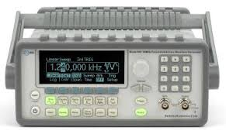
Function Generator
Function generators are used for generating different waveforms
Typical signals are sinusoidal, square, triangle and sawtooth
Used in equipment testing where signal are required

Slide 15
Function Generator Setup
The first step is to setup the probes. They act like the power supply probes
Next is to set the frequency and amplitude of the signal
You can also select the signal type at this time too
There other settings to play with such as frequency sweeps and DC voltage offsets
Note: Keep in mind the difference between Amplitude and VPP

Slide 16
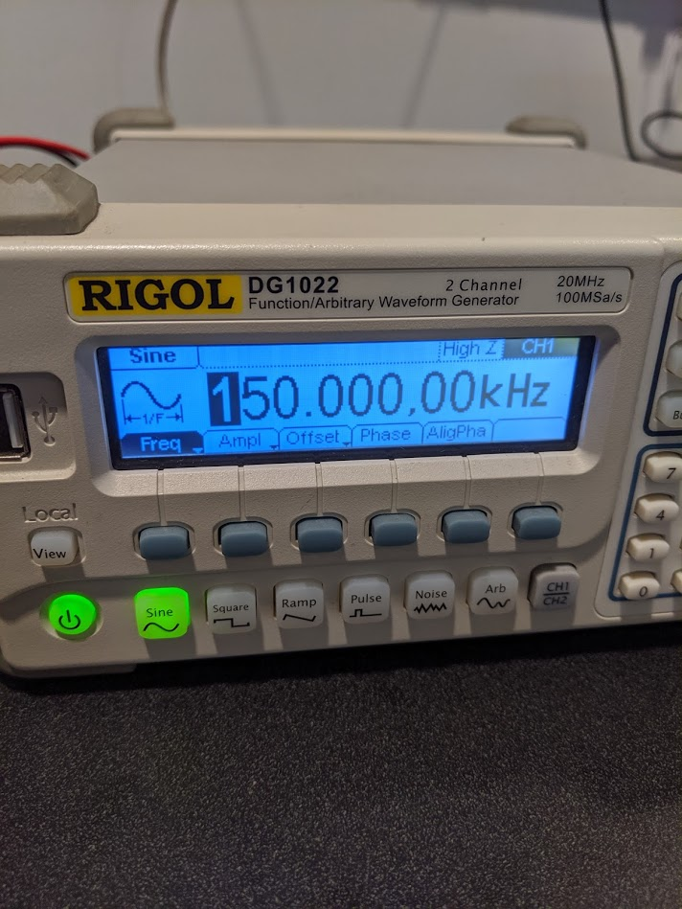
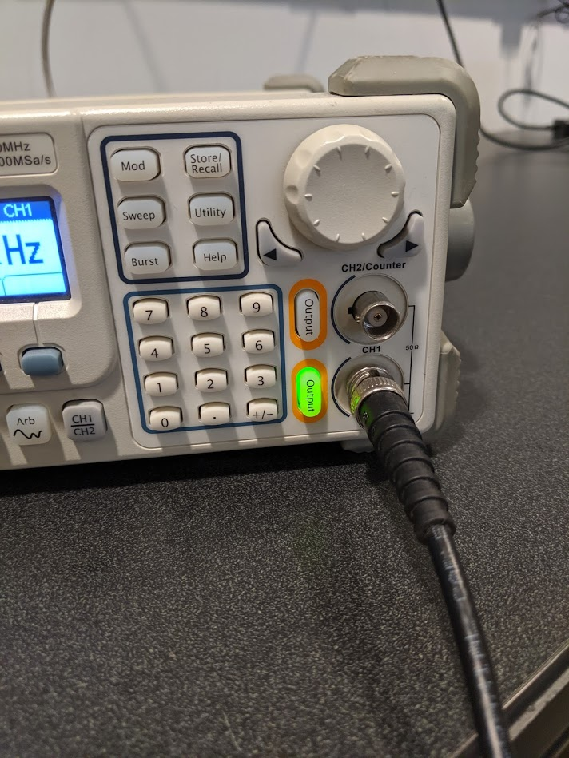
DEMO PICS
The function generator also has soft buttons though the most important are the wave shape and the freq, ampl, and offset keys
The cable for the function generator is similar to the one for the oscilloscope though the probes may terminate in alligator clips

Slide 17
Oscilloscopes
Oscilloscopes are used to view electrical signals(voltage) as waveforms
Have different levels of accuracy and range depending on the sampling frequency of the oscope
Can also display things such as amplitude of signal, frequency, rise time, fall time
Can be slightly variable in control between different brands but are generally all equipped with knobs to control the position and perspective of the signal
In use you use it in parallel with signals or voltages the same way you would use a DMM for voltage

Slide 18
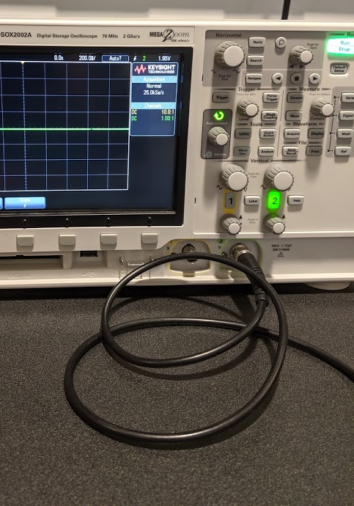
Controls the period of time shown on the display
Controls the trigger level (should be within the expected signal voltage range)
Controls the volt/division going up and down the monitor
Shifts the vertical view up or down to center signals that have DC offset

